Slide 1

Lecture
on
“Advanced Computer Architecture –TCS 704”
by
Akansha Gupta
DEPARTMENT OF COMPUTER SCIENCE AND ENGINEERING
GRAPHIC ERA DEEMED TO BE UNIVERSITY – 248002

Slide 2
Risc pipeline

Slide 3
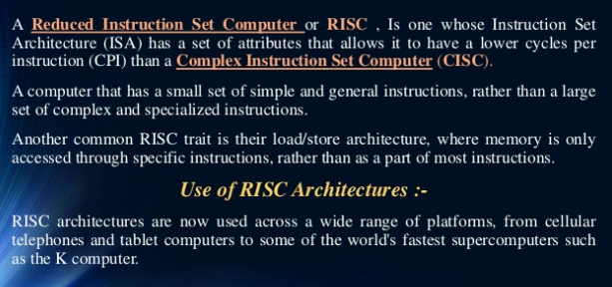
What Is RISC ?

Slide 4
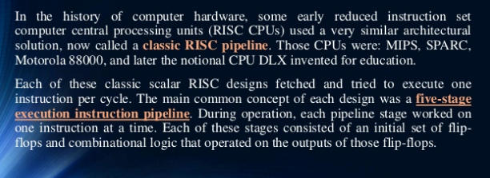
Introduction To RISC Pipeline

Slide 5
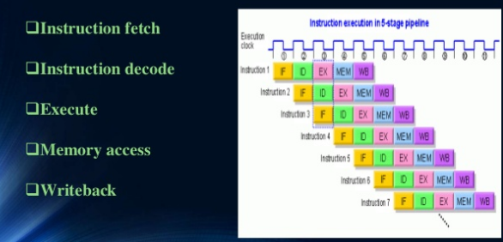
The Classic Five Stage RISC Pipeline

Slide 6
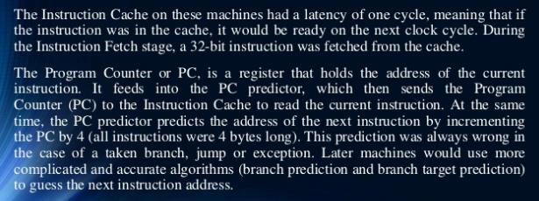
Instruction Fetch

Slide 7
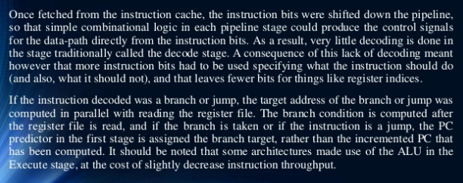
Instruction Decode

Slide 8
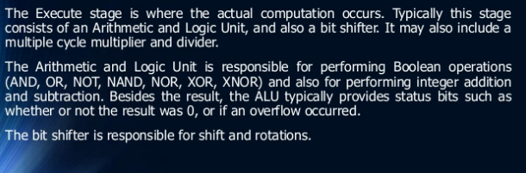
Execute

Slide 9
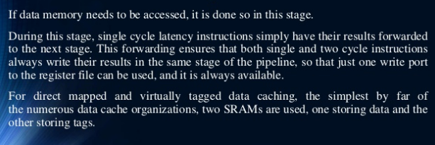
Memory Access

Slide 10
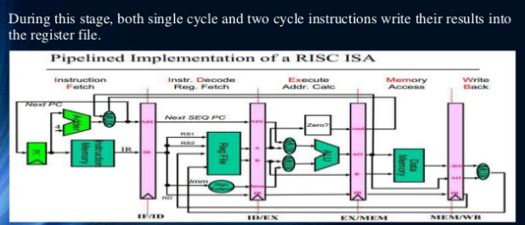
Write Back

Slide 11
https://youtu.be/TgfAxtz7xcQ
thanks

